Slide 1
College Planning
November 9, 2021

Slide 2
Agenda
Today we will discuss:
Class of 2022 College Counseling Timeline
Juniors’ College List Development & Initial Research
Preparing the college application ( Personal Statements, Activity tracker, Letters of Rec)
FAFSA & HESAA
Q&A

Slide 3
Recommended Senior Fall Priorities Calendar
 | August | September | October | November | December | January
College admissions |  | TESTING
College affordability
College selection
Personal & Supplemental Statements
Common Application Profile Review
Application Submission
TESTING
Financial Aid Documentation
FAFSA application
Financial Aid Literacy
CSS Profile application
Research
College List Development
Demonstrated Interest
Notes:
-find an alternative to common application name

Slide 4
Ideal Junior Spring Priorities Calendar
 | January | Feb | March | April | May | June
College admissions |  |  | Letters of Recommendation LettersLetters of Recommendation Letters of Recommendation of Recommendation
College affordability
College selection
College Knowledge
Personal Statements
Letters of Recommendation
Activity Tracker
TESTING
College Visits In-Person/Virtual, College Fairs
Financial Aid Documentation
Family Financial Aid Literacy
Preliminary College Research
Demonstrated Interest Opportunities
Summer Program

Slide 5
Personal Statements

Slide 6
Personal Statement
Avoid common topics, connection and language
Topic Development
Your personal statement answers the question, “ What world do you come from and how has it shaped you?” and has 5 essential qualities
Ex: an essay about sports, teamwork, & using language such as “ teamwork makes the dream work”
Look over the writing prompts on common app
Ask your English teacher for model essays
*The purpose of the personal statement is to demonstrate to colleges that a student will make a valuable contribution to the college community via their special skills, attitudes, and values. *
Vulnerability,
Variety of 3-4 core values
Insight/ “So what?”
Elasticity (meaning that it rounds out the rest of the application)
Craft (the essay has good structure and is proofread.

Slide 7
Common App Essay Prompts
Some students have a background, identity, interest, or talent that is so meaningful they believe their application would be incomplete without it. If this sounds like you, then please share your story.
The lessons we take from obstacles we encounter can be fundamental to later success. Recount a time when you faced a challenge, setback, or failure. How did it affect you, and what did you learn from the experience?
Reflect on a time when you questioned or challenged a belief or idea. What prompted your thinking? What was the outcome?
Reflect on something that someone has done for you that has made you happy or thankful in a surprising way. How has this gratitude affected or motivated you?
Discuss an accomplishment, event, or realization that sparked a period of personal growth and a new understanding of yourself or others.
Describe a topic, idea, or concept you find so engaging that it makes you lose all track of time. Why does it captivate you? What or who do you turn to when you want to learn more?

Slide 8
Teacher Recommendation

Slide 9
LORs
Give teachers/coaches/mentors sufficient time to prepare high-quality letters of recommendation
A letter of recommendation provides insight regarding the personal qualities and interests of students, as well as provides more detail on academic performance.
Mentors: Letters of recommendations play a pivotal role in the admission process. As a supplement to a student’s test scores, GPA, course rigor and personal statement, a strong recommendation letter can elevate a student’s likelihood of admission
Suggestions:
Seniors: Reach out to your teachers and ask if they will be willing to write you a LOR
Give your teachers at least 3 weeks notice

Slide 10
Which teachers do I ask to write my LOR?

Slide 11
Letters of Recommendation
Very Selective
Selective
Two content teachers. Ideally from an instructor who recently taught them.
Ex: Rutgers University
Two content teachers. Ideally from a core instructor (Math, History, English) who recently taught you or is currently teaching you. Diversity from department: 1 from STEM and 1 from Humanities
Ex: Princeton/Yale University
Somewhat Selective
One content teacher. Can be a teacher who taught you during your Sophomore year
Ex: Felician

Slide 12
Timeline for Juniors’ LORs
March- June
Fill out questionnaire or info sheet that offers information to the recommender
Student can submit resume or activity tracker to clarify your activities
If students elect their recommenders, they typically:
request a recommendation via email and/or through Naviance
clearly communicate WHAT the letter of recommendation is for (college, scholarship, program)
provide the recommender an appropriate amount of time (i.e. 2-3 weeks before submission)
manage their own timeline, i.e. ask at the end of junior year or summer between 11th and 12th

Slide 13
Getting Started on the College List

Slide 14
College List Development
Academic Match: Research shows that “students are most likely to persist and graduate when they attend the most academically demanding institution that will admit them.”
Campus Culture Fit: Student’s cultural and personal needs and interests align with the college’s mission, resources, first-gen and/or underrepresented minority programming, etc.
Competitive Graduation Rates: The college graduation rate is a strong indicator of success (Note: Consider colleges with a 53% or higher graduation rate)
Affordability: Among accepted colleges, colleges with out-of-pocket costs of less than or equal to $5,000 and minimal student and parent debt (recommendation: only student federal loans)

Slide 15
How many schools should I apply to?
Recommended # of submitted college applications your Senior year
15-20
# of colleges included in your preliminary list by end of junior year
10-12
College List
25% Safety
50% Target
25% Reach

Slide 16
Activity Tracker

Slide 17
Why create an Activity Tracker
Students who complete an activity tracker prior to 12th grade will have time to develop a comprehensive list that aligns to the student’s narrative and highlights significant leadership experience.
Colleges see the list of clubs, organizations, work, and volunteership as a glimpse into how the student will engage on their college campus.
A strong activity list with leadership and high engagement can set a student apart from a competitive application pool, especially for Very Selective colleges.
Note: Not all activities are equal in the eyes of college admission representatives.
Colleges look for:
Consistency
Leadership
Alignment to student narrative

Slide 18
Suggestions
Students add sports, clubs, volunteership, employment, summer programs, family obligations, participation different organizations
Rank all activities according to importance and describe why each is significant to them.
Brainstorm activities no later than the Spring Semester of your junior year. Ideally, students begin this process in the 9th grade and update their activity tracker annually.

Slide 19
FAFSA

Slide 20
What Will You Need…
2022-2023 FAFSA opened October 1st
2020 Federal Tax Return
2020 W-2 Form(s)
FSA ID for both Student and Parent
Driver License (Student)
How to complete FAFSA…
Studentaid.gov or fafsa.gov
Mobile Device
PDF

Slide 21
Federal Aid Programs
Acronym | Program Name | Annual Award
FPELL | Federal PELL Grant | Up to $6,495
*FSEOG | Federal Supplemental Educational Opportunity Grant | Up to $4,000
TEACH | Teacher Education Assistance for College and Higher Education | Up to $3,772
*FWS | Federal College Work-Study | Varies
Campus based-aid distributed based on financial need Awards subject to change for 2022-2023 academic year

Slide 22
Federal Direct Loan Program Student Loan Interest Rates
Subsidized Interest rate 3.73% - 1.057% fee
Loans made to students who demonstrate need
Interest paid by the government during periods of in-school and authorized deferments
Borrowers receive a six month grace period before repayment begins
For all new Stafford loans made on or after July 1, 2012, interest accrues once the student is no longer enrolled at least half time.

Slide 23
Continuation…
Unsubsidized Interest rate 3.73% (5.28% for Graduate or Professional Students) - 1.057% fee
Loans made to students
Interest is the responsibility of the borrower at all times
Interest can be paid on a quarterly basis while in school or borrower can have the interest capitalized and added to the loan principal
Available for dependent students whose parents do not support them and refuse to provide parental data.
Federal PLUS Interest rate 6.28% - 4.228% fee
Loans available to parents of dependent undergraduate students
Loan is unsubsidized, federally guaranteed education loan with no annual or aggregate limits
Credit check is required to determine eligibility

Slide 24
Federal Aid Estimator
Can be used by students, parents, and college access professionals who want to get an early estimate of what aid may be available to a student considering college or career school
To use estimator, you will need Federal tax return for the student and parent(s) and information on savings, investments, and assets for the student and parent if applicable
It will take up to 10 minutes to complete!

Slide 25
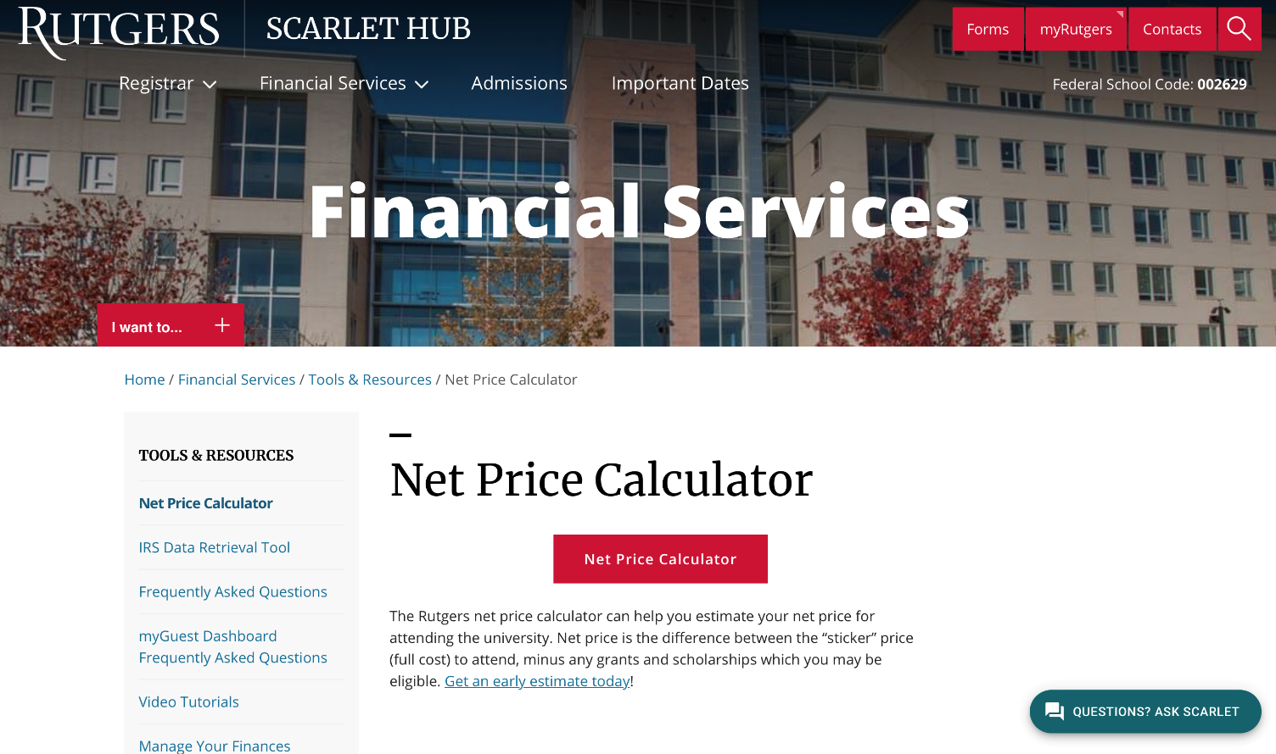
Net Price Calculator
Allows prospective students to enter information about themselves to determine the cost of attending a college or university
Every college and university is required to have it on their website
The calculator will provide the expected cost of the college or university after all grants and scholarships have been applied
Based on full-time, first degree/certificate undergraduate students

Slide 26
HESAA
State Aid

Slide 27
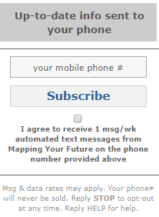
How to Apply for State Aid
Complete the FAFSA within state established deadlines
Students must create NJ FAMS Login
Students should always check their “To Do List” on NJ FAMS
Sign up for push notifications for reminders of FAFSA filing deadlines, to check your “To Do List,” and complete your state record

Slide 28
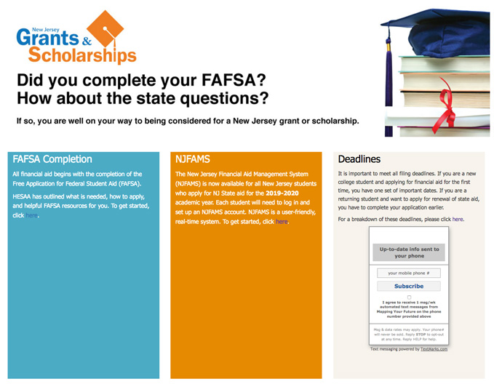
NJFAMS Login

Slide 29
NJ FAMS
Students who have filed a FAFSA will receive an email instructing them to create their own username and password by selecting the “Create Student Login link” from the login screen.
After creating their username and password, the student will receive an activation email with the subject line NJHESAA Web Portal User Activation
To complete the registration process the student must click on the link in the email to activate their account
After activation, the student will be able to log into NJ FAMS

Slide 30
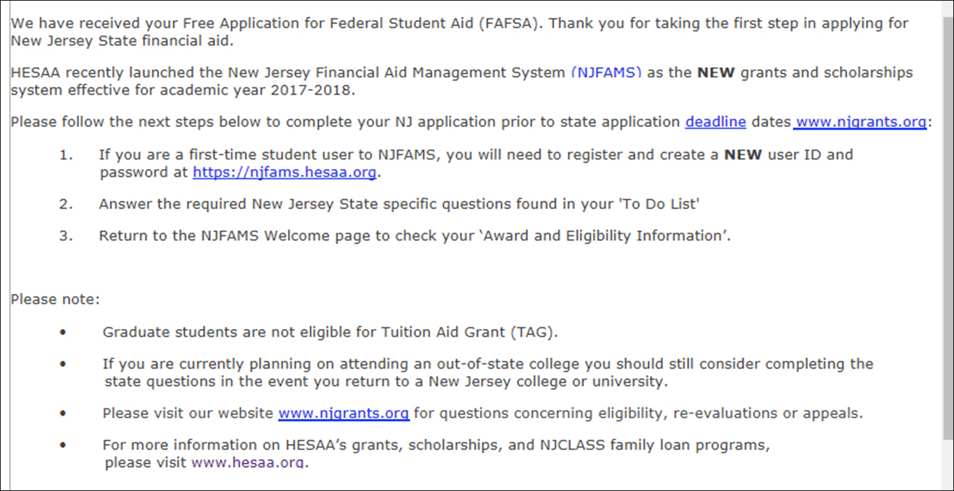
Example of Email Sent to Students

Slide 31
College Choice on NJ FAMS
Students have to update both FAFSA and NJ FAMS with their college choice. NJ schools no longer have to be listed first. If a student does not list a NJ college, the student will receive an NJ FAMS message that says “No FAFSA” on file.

Slide 32
Questions…

